Slide 1
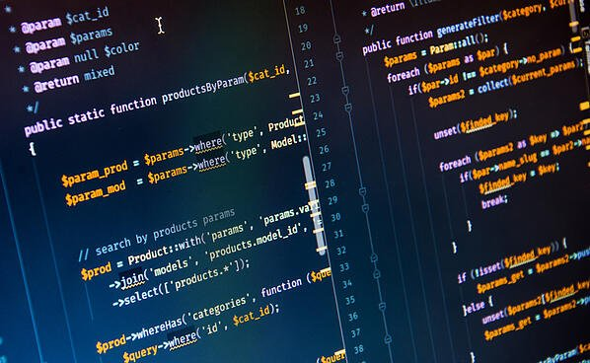
Digits Recognition using Logistic Regression and Neural Networks
Made By:
Mohd. Sheesh Saifi

Slide 2
Introduction
Machine learning (ML) is the study of computer algorithms that improve automatically through experience. It is seen as a subset of artificial intelligence. Machine learning algorithms build a model based on sample data, known as "training data", in order to make predictions or decisions without being explicitly programmed to do so. Machine learning algorithms are used in a wide variety of applications, such as email filtering and computer vision, where it is difficult or unfeasible to develop conventional algorithms to perform the needed tasks.
The main objective of the project is to use logistic regression with neural networks to perform machine learning on a dataset of digits so that we can later recognize them.

Slide 3
LOGISTIC rEGRESSION
Logistic regression is a statistical model that in its basic form uses a logistic function to model a binary dependent variable, although many more complex extensions exist. In regression analysis, logistic regression (or logit regression) is estimating the parameters of a logistic model (a form of binary regression).
In simple words, Logistic Regression is a classification Algorithm. It is used to model the probability of certain events like pass/fail, win/lose, healthy/sick, etc.
A neural network is a series of algorithms that endeavors to recognize underlying relationships in a set of data through a process that mimics the way the human brain operates. In this sense, neural networks refer to systems of neurons, either organic or artificial in nature.

Slide 4
Methodology
Identifying the project area
Identifying the type of data that is to be classified.
Using relevant algorithm on dataset for machine learning.
Learn parameters and Visualize the result.
Test the results.

Slide 5
ABSTRACT
Handwritten character recognition is one of the practically important issues in pattern recognition applications. The applications of digit recognition includes in postal mail sorting, bank check processing, form data entry, etc. The heart of the problem lies within the ability to develop an efficient algorithm that can recognize hand written digits and which is submitted by users by the way of a scanner, tablet, and other digital devices.
The challenge in handwritten character recognition is mainly caused by the large variation of individual writing styles. Hence, robust feature extraction is very important to improve the performance of a handwritten character recognition system. Nowadays handwritten digit recognition has obtained lot of concentration in the area of pattern recognition system sowing to its application in diverse fields.

Slide 6
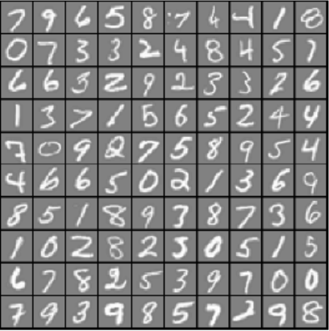
Visualizing the dataset
Few Examples from the dataset

Slide 7
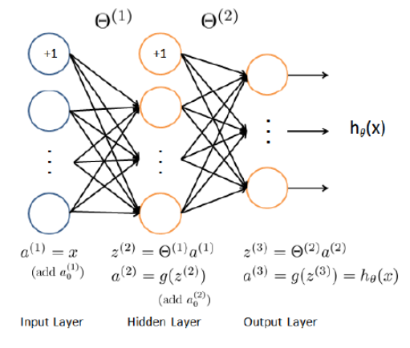
Model representation
Neural Network Model used

Slide 8
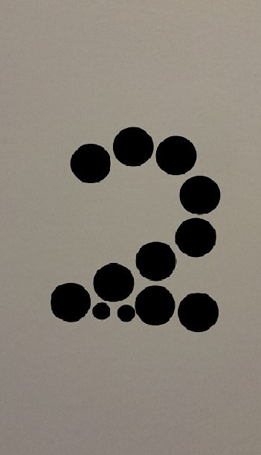
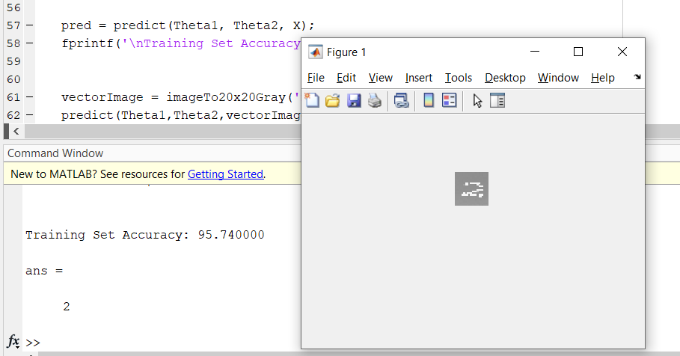
RESULT
Recognition of a digit:-
Input
Output

Slide 9
CONCLUSION
We trained our Neural network of Logistic Regression Algorithm with a digits dataset of different type of fonts.
Then, we used the trained network to predict an unknown image of a digit.

Slide 10
github link of this project
https://github.com/Sheesh-Saifi/Logistic-Regression-with-neural-network

